Slide 1
An Integrated GPU Power and Performance Model
Sunpyo Hong, Hyesoon Kim

Slide 2
Outline
Motivation
Integrated Performance and Power (IPP) Modules
Results
Conclusion

Slide 3
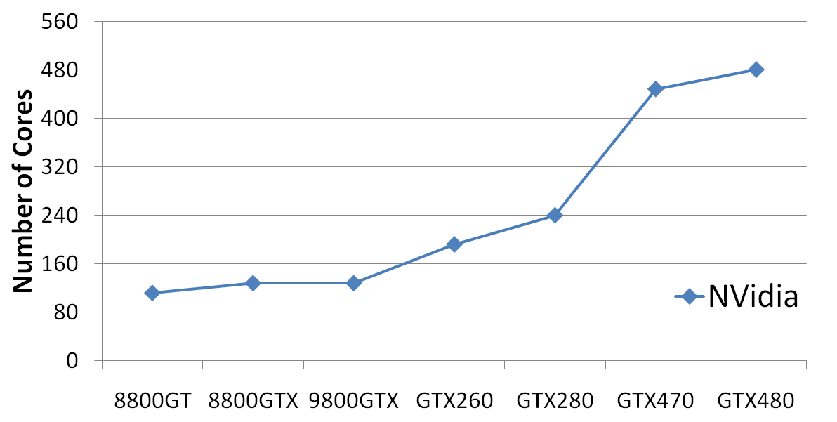
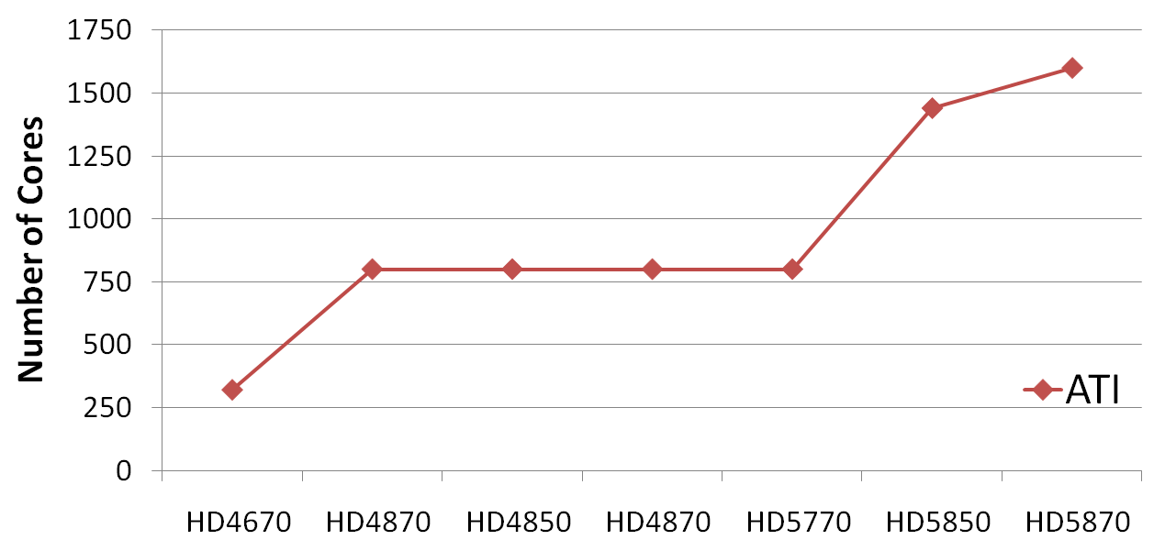
Motivation
GPUs have become popular for running general applications
GFLOPS significantly increasing
Cost: Increasing number of cores
2010
2010
2009
2007
2008
2008

Slide 4
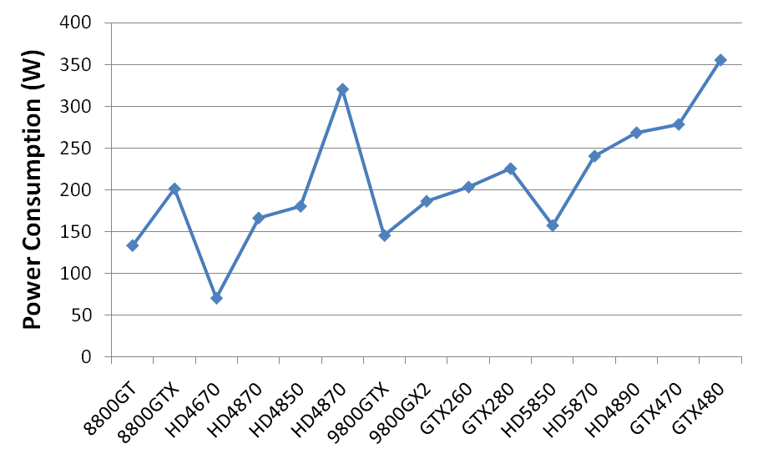
Motivation
Power consumption has also been increasing
2010
2007
2009
2008
Effects of increased number of cores and power ?
Relationship with respect to performance ?

Slide 5
IPP System
Propose the Integrated Performance and Power system (IPP)
H/W Dynamic Power Manager
GPU Kernel
Performance Prediction
Performance / Watt Prediction
Programmer
Number of Active Cores Prediction
Power, Temperature
Prediction
Compiler
IPP System
Performance Prediction (ISCA 2009)
Power, Temperature Prediction
Performance / Watt, Number of Active Cores Prediction

Slide 6
Performance, Power, Perf / Power
What kinds of applications will get benefit with fewer cores ?
Type 1
Type 1
Power (W)
Performance
Type 2
Performance / Watt
Type 2
# Active Cores
# Active Cores
# Active Cores
GOAL: To maximize the performance/watt metric by using fewer cores for Type II applications

Slide 7
Outline
Motivation
Integrated Performance and Power (IPP) Modules
Results
Conclusion

Slide 8
IPP System Modules
Performance Prediction
Performance / Watt Prediction
Number of Active Cores Prediction
Power, Temperature
Prediction
IPP System
Performance Prediction
Power, Temperature Prediction
Performance / Watt, Number of Active Cores Prediction

Slide 9
Power Prediction Module
Methodology is based on the empirical CPU power model (Isci’03)
GPU_Power =
Runtime_power + Idle_Power
Runtime_power =
Σ
Runtime_power_component
=
Σ
AccessRate x MaxPower
How often unit is accessed
Maximum allowable power consumption
Divide GPU into architectural units and know which unit is active

Slide 10
GPU Architectural Units
GPU
Which architectural unit is accessed ?
SM
SM
SM
SM
SM
No speculative execution
Memory
Other Logics
Associate each instruction with a specific arch. unit
SM
PTX Instruction | Arch. Unit
All Instructions | FDS (Fetch/ Decode/ Scheduler)
Add_fp Sub_fp Mul_fp Fma_fp Neg_fp Min_fp Lg2_fp Ex2_fp Mad_fp Div_fp Abs_fp | FP Unit
Sin_fp Cos_fp Rcp_fp Sqrt_fp Rsqrt_fp | SFU
Fetch/Decode /Schedule
Register File
ALU
INT Units
FP Units
Texture Cache
Constant Cache
SFU
APP

Slide 11
Access Rate
Runtime_power_component =
AccessRate x MaxPower
How often the architectural unit is accessed per unit of time
DAC_per_th x Warps_per_SM
_________________________
AccessRate =
Exec_cycles / 4
Active number of threads allocated per SM
Data access count (DAC) per thread:
Total number of accesses to a specific unit
Predicted execution cycles

Slide 12
Max Power Parameters (I)
Runtime_power_component =
AccessRate x MaxPower
Allowable maximum power consumption per arch. unit
Microbechmarks
P₁
P₂
P₃
.
.
.
P_{n}
AR_{1A}
AR_{2A}
AR_{3A}
.
.
.
AR_{nA}
AR_{1B}
AR_{2B}
AR_{3B}
.
.
.
AR_{nB}
. . .
. . .
. . .
.
.
.
. . .
AR_{1Z}
AR_{2Z}
AR_{3Z}
.
.
.
AR_{nZ}
M_{A}
M_{B}
M_{C}
.
.
.
M_{Z}
FP
SFU
INT
Global Memory
Shared Memory
Texture Cache
Constant Cache
=
X
Measured
Power
AccessRate
Maximum power per arch. unit
Solve for the set of MaxPower values (M_{A}, M_{B}, … , M_{Z})

Slide 13
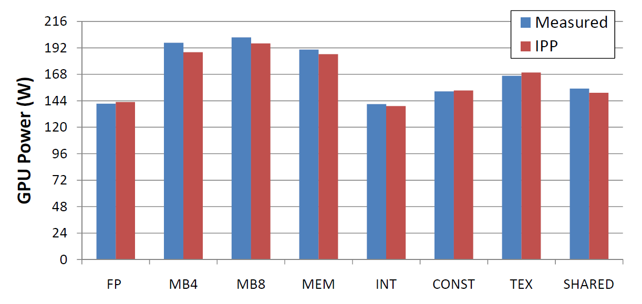
Max Power Parameters (II)
Empirical Power Parameters
Units | MaxPower
FP | 0.2
REG | 0.3
ALU | 0.2
SFU | 0.5
INT | 0.25
FDS (Fetch/Dec/Sch) | 0.5
Shared memory | 1
Texture cache | 0.9
Constant cache | 0.4
Const_SM | 0.813
Global memory | 52
Local memory | 52
Power Consumption vs. Model (GTX280)
The prediction error of microbenchmarks is 2.7%

Slide 14
Runtime Power
Σ
GPU_Power =
Runtime_power_component + Idle_Power
Runtime_power_component =
AccessRate x MaxPower
GPU
Application
Accessing
Fetch / Decode / Schedule
Registers
FP Unit
Memory System
5 W
5 W
5 W
40 W
5 W
5 W
2W
15 W
=
27 W

Slide 15
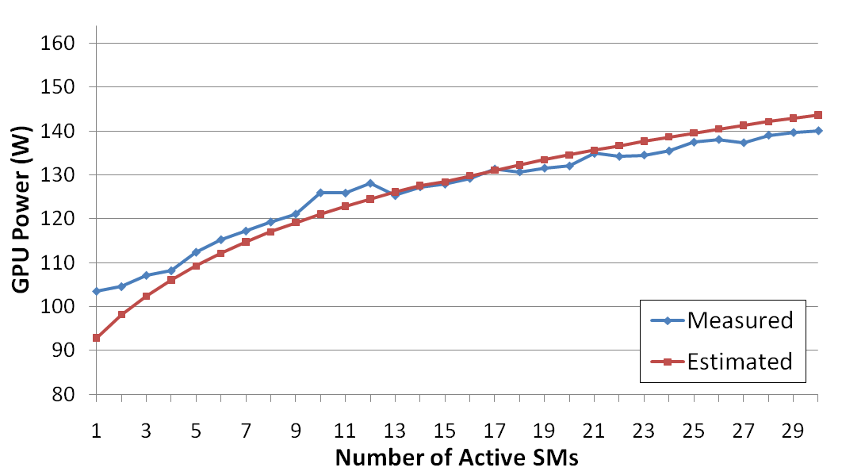
Power vs. Number of Active SMs
Power consumption also depends on the number of Active SMs
Modeled by using an logarithmic function
Power_SMs = Max_SM x log10(α x Active_SMs + β)
α = (10 - β) / Num_SMs, β = 1.1

Slide 16
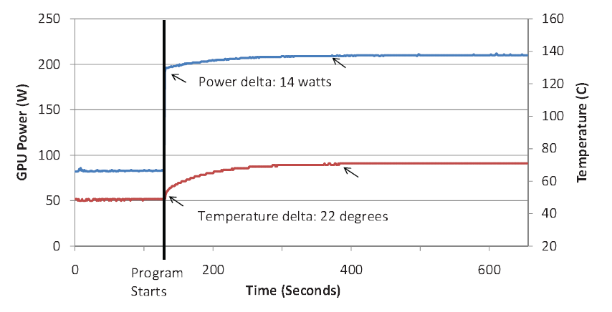
Temperature Effects
Temperature effects on power consumption
Power delta: 14 watts
GPU Power (W)
Temperature (C)
Temperature delta: 22 degrees
ΔPower
ΔTemperature
Higher power consumption due to increased temperature is also modeled

Slide 17
IPP System Modules
Performance Prediction
Performance / Watt Prediction
Number of active cores prediction
Power / Temperature
Prediction
IPP System
Performance Prediction
Power, Temperature Prediction
Performance / Watt, Number of Active Cores Prediction

Slide 18
Performance Metrics
MWP: Metric of Memory-level Parallelism
1
1
MWP=4
Maximum number of warps that can overlap memory accesses
2
2
3
3
4
4
CWP: Computation Warp Parallelism
MWP = 2
1
1
3
2
4
Number of warps that execute during a memory access period
2
3
4
CWP = 4
Memory
Waiting period

Slide 19
Performance Predictions
Case 1: MWP> CWP
Case 2: CWP > MWP
Case 3: Not Enough Warps (N=CWP and N=MWP)
Performance is dominated by the computation cycles
Performance is dominated by the memory cycles
Under-utilized cycles

Slide 20
IPP System Modules
Performance Prediction
Performance / Watt Prediction
Number of Active Cores Prediction
Power, Temperature
Prediction
IPP System
Performance Prediction
Power / Temperature Prediction
Performance / Watt, Number of Active Cores Prediction

Slide 21
IPP System
Performance / Watt Prediction
Performance Prediction
Performance / Watt Prediction
Number of Active Cores Prediction
Power, Temperature
Prediction
IPP System
-> Use the outputs from the performance and power modules
Performance prediction
____________________
=
Power prediction

Slide 22
IPP System
Number of Active Cores Prediction
-> First check if it’s not possible to saturate bandwidth
1) Not Enough Warps
Not enough warps to saturate BW
2) CWP < MWP
Computationally-intensive code
3) MWP < MWP_peak_BW
Does not reach the machine’s peak BW
-> Choose the maximum # of cores if any condition is true

Slide 23
IPP System
Otherwise, find the number of cores that saturates BW
Memory Bandwidth
Number of Cores
_________________
=
BW_per_warp x N
Bandwidth that each core uses
Machine specified BW parameter (GB/s)
BW_per_warp : Bandwidth each warp consumes
N : # warps allocated per core

Slide 24
Outline
Motivation
Integrated Performance and Power (IPP) Modules
Results
Conclusion

Slide 25
Benchmarks
Benchmark | Description | Bandwidth (GB/s)
SVM | Kernel from a SVM-based algorithm | 54.679
Binomial (Bino) | American option pricing | 3.689
Sepia | Filter for artificially aging images | 12.012
Convolve (Conv) | 2D Separable image convolution | 16.208
Blackscholes (Bs) | European option pricing | 51.033
Cmem | Matrix add FP operations | 64.617
Matrixmul (Nmat) | Naive version of matrix multiplication | 123.33
Dotp | Matrix dotproduct | 111.313
Madd | Matrix multiply-add | 115.058
Dmadd | Matrix double memory multiply add | 109.996
Mmul | Matrix single multiply | 114.997
Evaluated various GPGPU Benchmarks
Bandwidth limited vs. Non-bandwidth limited

Slide 26
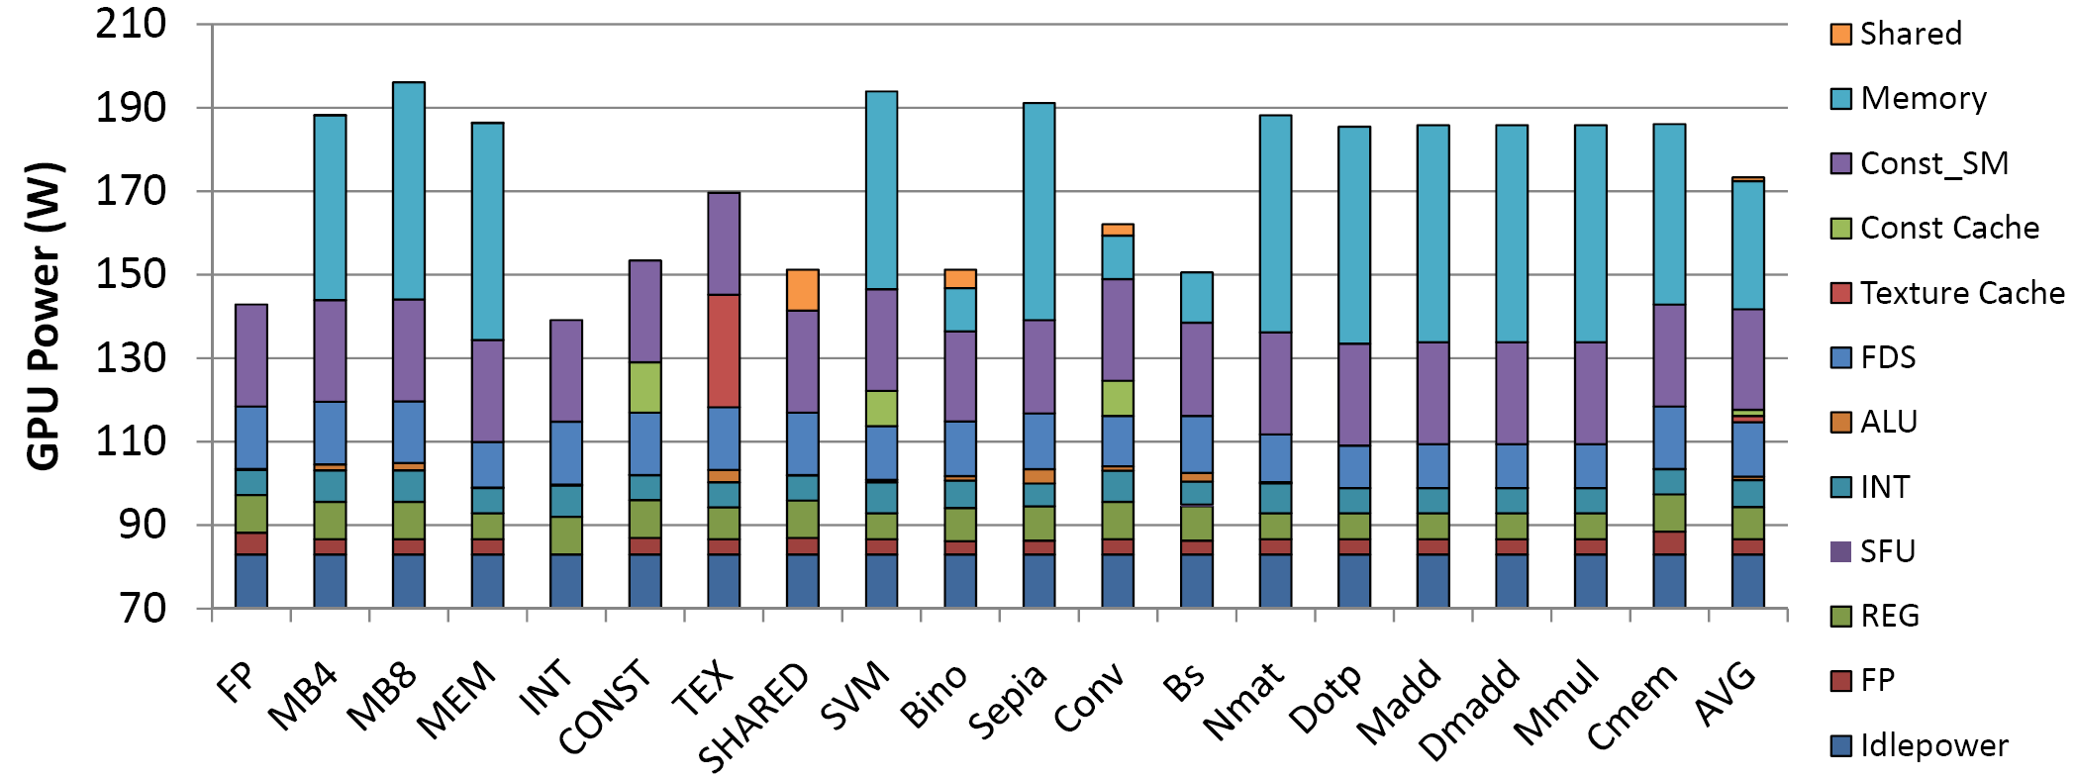
Power Decomposition
Power breakdown graph for each benchmark
Average power prediction error for GPGPU apps is 8.94%

Slide 27
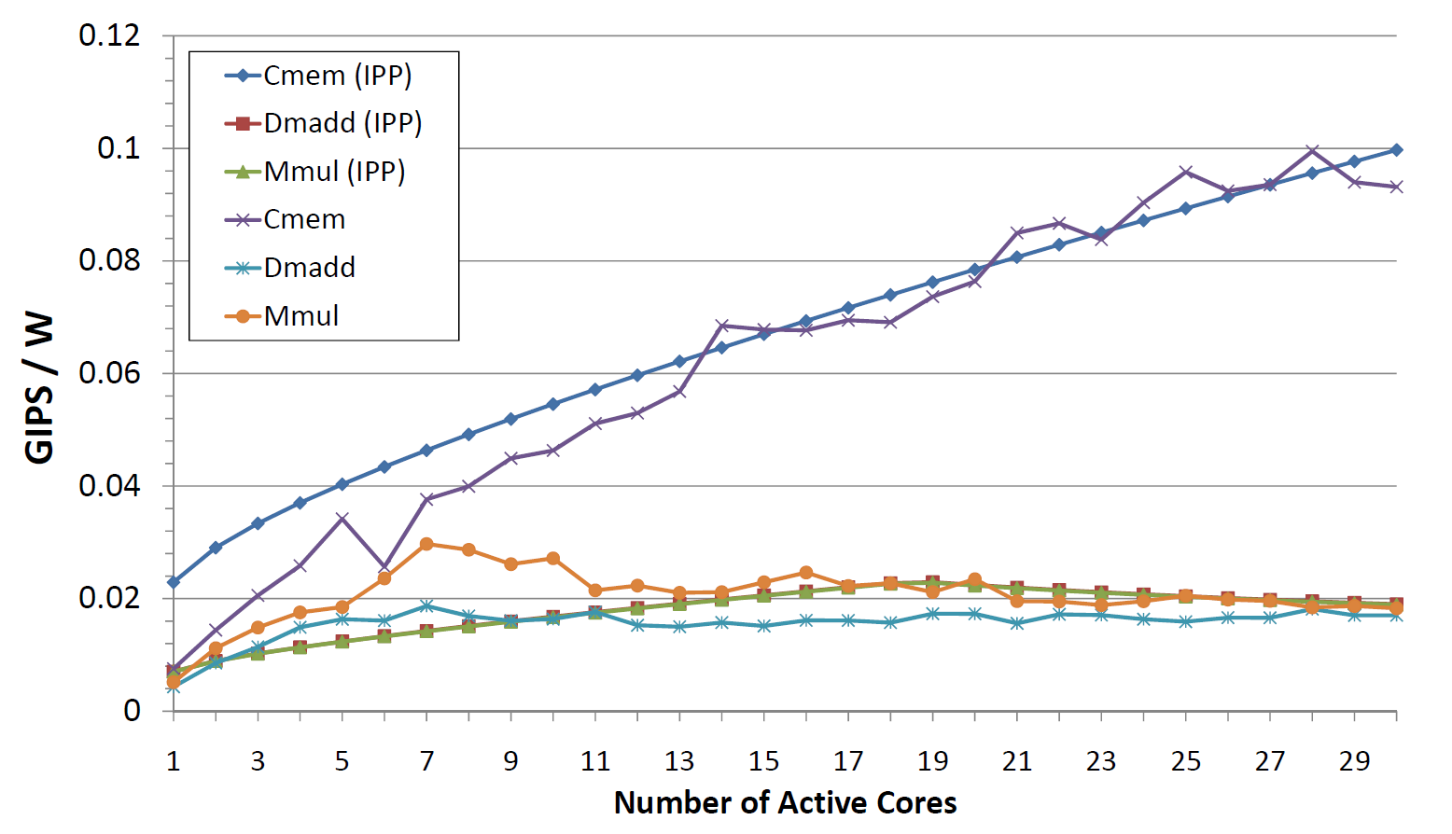
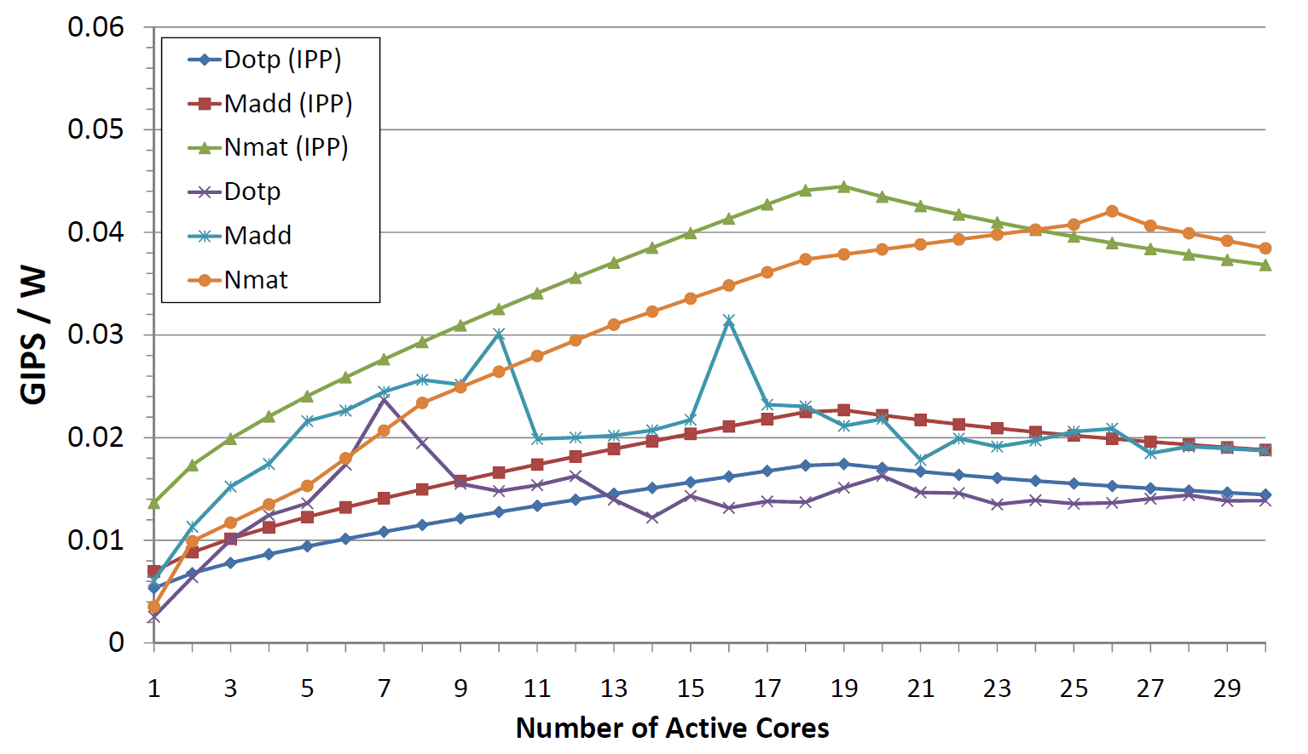
Performance Per Watt
IPP
IPP
IPP
Number of Active Cores
Number of Active Cores
Performance per watt vs. Number of active cores
IPP achieves 85% of the best manual mapping for saving energy

Slide 28
Energy Savings
The energy saving measured for runtime is 10.9%
With power-gating, the energy saving prediction is 25.8%

Slide 29
Outline
Motivation
Integrated Performance and Power (IPP) Modules
Results
Conclusion

Slide 30
Conclusions
Introduced IPP (Integrated Power and Performance System) for GPU architecture and GPGPU kernels
IPP extends the empirical CPU power model to GPU side
IPP predicts the number of cores that will achieve the energy savings
Power Prediction
For GPGPU benchmarks, the prediction error is 8.9%
Saved 10.9% energy for bandwidth-limited apps with fewer cores
Estimated the energy saving for power-gated system is 25.8%

Slide 31
Thank you

